Slide 1
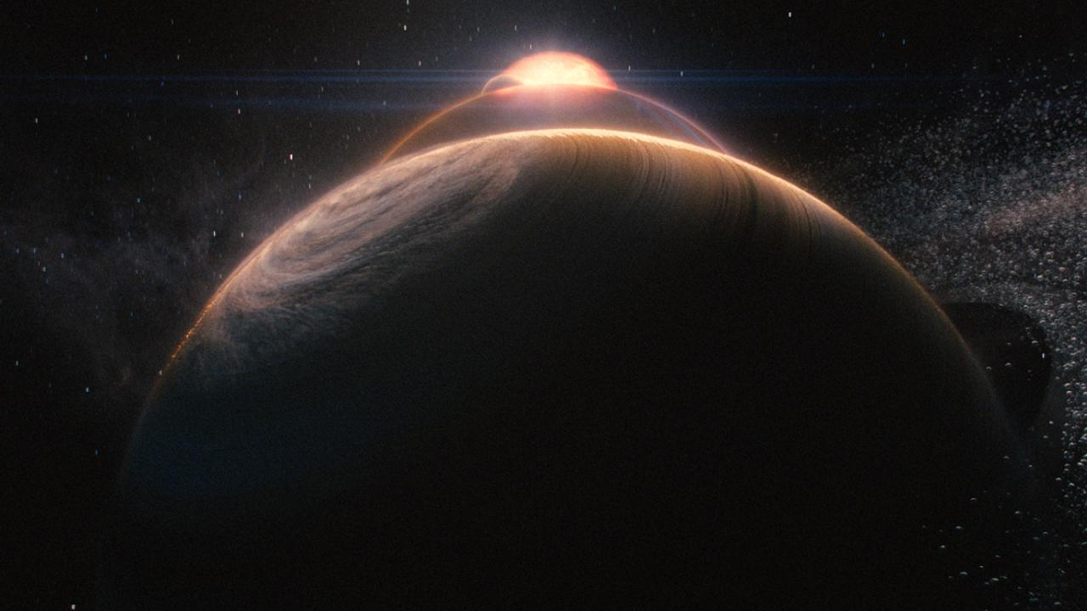

Shiny Pixels and Beyond: Real-Time Raytracing at SEED
Johan Andersson & Colin Barré-Brisebois
Electronic Arts

Slide 2


Slide 3
Watch the trailer here: https://www.youtube.com/watch?v=LXo0WdlELJk

Slide 4
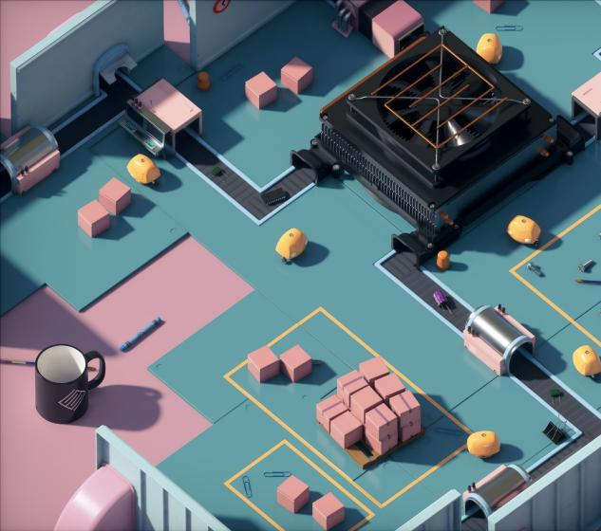
S E E D // Shiny Pixels and Beyond: Rendering Research at SEED
“PICA PICA”
Exploratory mini-game & world
For our self-learning AI agents to play, not for humans ☺
Uses SEED’s Halcyon R&D engine
Goals
Explore hybrid raytracing with DXR
Clean and consistent visuals
Procedurally-generated worlds
No precomputation

Slide 5
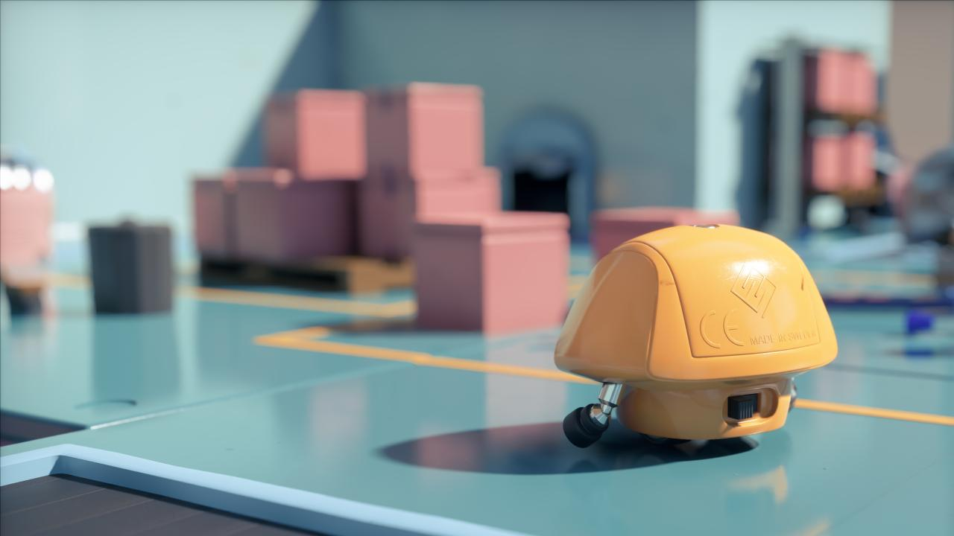
S E E D // Shiny Pixels and Beyond: Rendering Research at SEED
Why raytracing?
Flexible new tool in the toolbox
Solve sparse & incoherent problems
Unified API + performance (DXR + RTX)
Simple high quality - easy ground truth

Slide 6
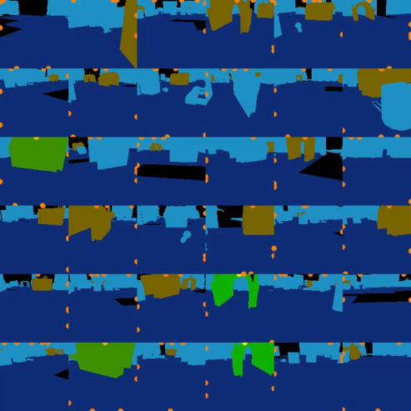
S E E D // Shiny Pixels and Beyond: Rendering Research at SEED
Self-Learning AI
Using deep reinforcement learning
“Imitation Learning with Concurrent Actions in 3D Games” [Harmer 2018]
36 semantic views - 1550 fps
Training with TensorFlow
Future: Inference with WinML
See “Deep Learning - Beyond the Hype” tomorrow

Slide 7
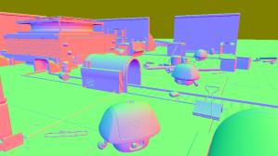
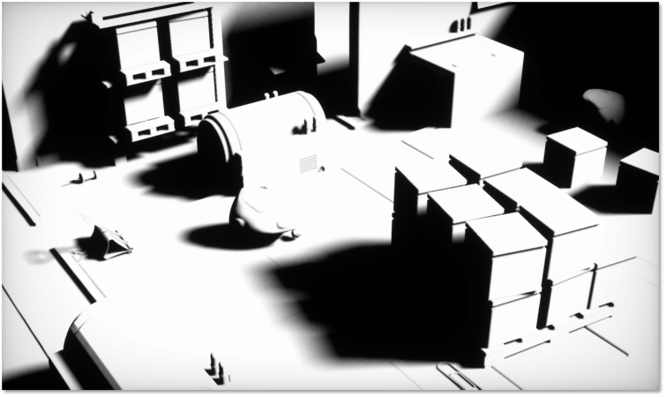
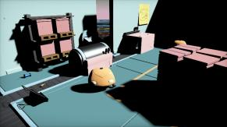
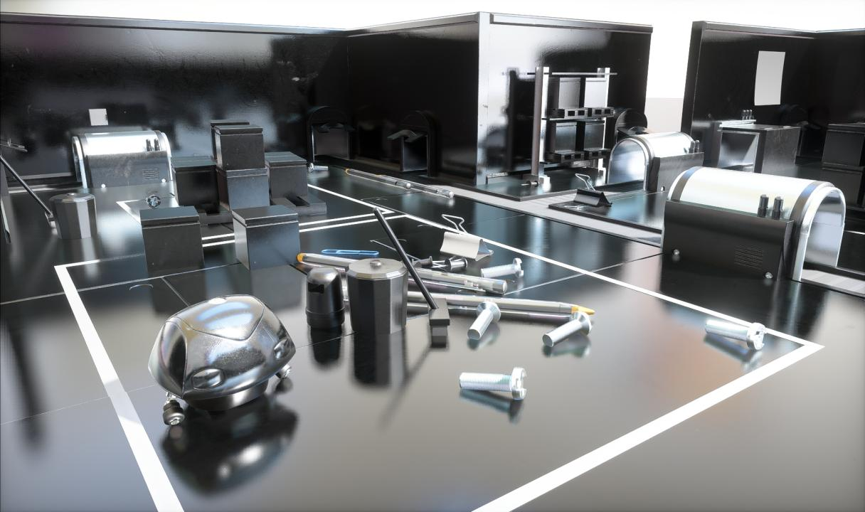
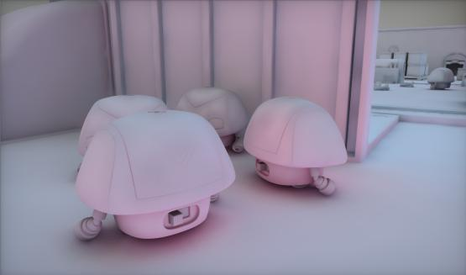
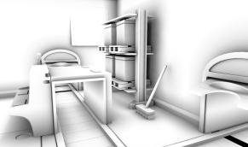
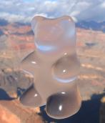
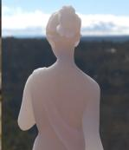
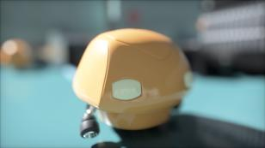
S E E D // Shiny Pixels and Beyond: Rendering Research at SEED
Hybrid Rendering Pipeline
Deferred shading (raster)
Direct shadows
(raytrace or raster)
Direct lighting (compute)
Reflections (raytrace)
Global Illumination (raytrace)
Ambient occlusion
(raytrace or compute)
Transparency & Translucency
(raytrace)
Post processing (compute)

Slide 8
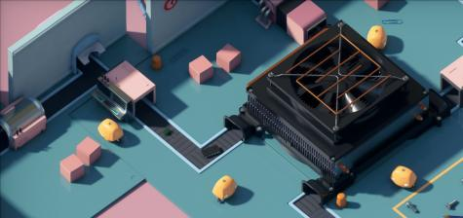

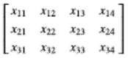
S E E D // DirectX: Evolving Microsoft's Graphics Platform
?
Spawn a Mesh?
DXR: build its bottom acceleration structure
Multiple geometries for multiple materials
Triangles, AABBs, custom
Mesh instances specified in top acceleration
Move a Mesh?
Update the instance’s position/orientation in the top acceleration
Spawn [some] Rays?
Multiple Hit and Miss shaders possible
Inst. 1
Inst. 2
Inst. 3
Inst. 4
Inst. 5
Top Acceleration
Mesh 1
Mesh 2
Mesh 3
Bottom Acceleration
R
R
R
R
M
M
H
H
H
H
H
H
H
H
H
H
H
H
H
H
H
…
…
…
Shader Table

Slide 9
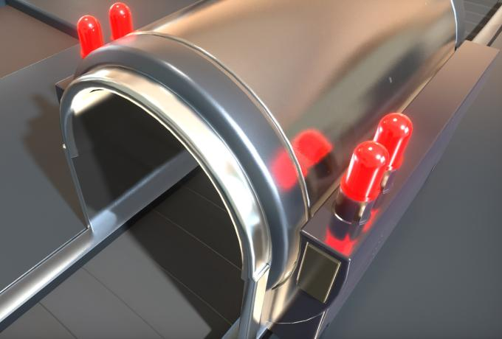
S E E D // DirectX: Evolving Microsoft's Graphics Platform
Raytraced Reflections
Rasterize primary visibility
Launch rays from the G-Buffer
Raytrace at half resolution
Reconstruct at full resolution
Spatiotemporal filtering
Works on both flat and curved surfaces
Raytraced Reflections

Slide 10
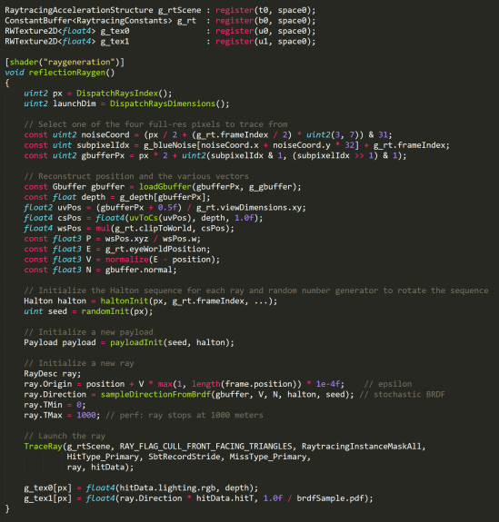
S E E D // DirectX: Evolving Microsoft's Graphics Platform
Reflection Rays
Let’s launch some reflection rays:
Select one of the (2x2) pixels to trace
Reconstruct position and vectors
Initialize Halton & random number seq.
Initialize the payload
Prepare a new ray
Trace
Gather results from ray payload
Reflection Color, Direction, HitT, 1/pdf
1
2
3
4
5
6
7
Reflections Raytracing HLSL Pseudo-Code

Slide 11
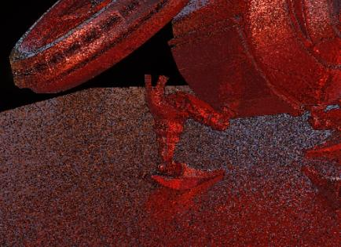
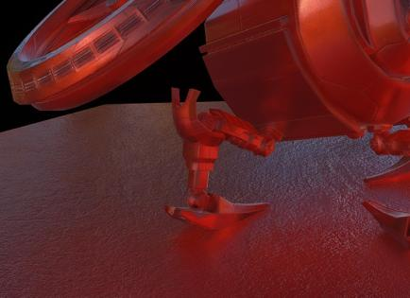
S E E D // DirectX: Evolving Microsoft's Graphics Platform
Reflection Filtering
Inspired by Stochastic Screen-Space Reflections [Stachowiak 2015]
For every full-res pixel, sample 16 pixels in half-res ray results
Blue Noise offsets, decorrelated every 2x2 pixels
Build color bounding box of ray-hit results
Clamp temporal history to bounding box
Followed by a variance-driven bilateral filter
Helps with rough reflections
Unfiltered (Top) and Filtered (Bottom) Results

Slide 13
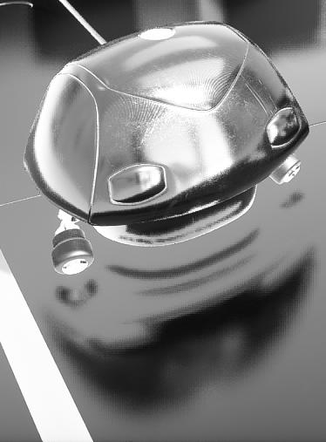
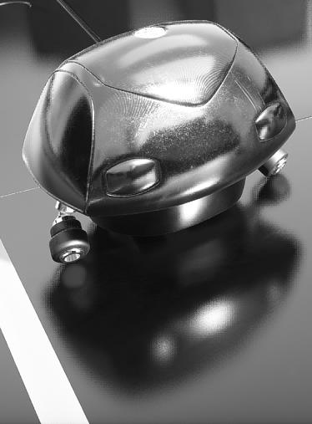

Screen-Space Reflections
G-Buffer Raytraced
Path Tracing Reference

Slide 14
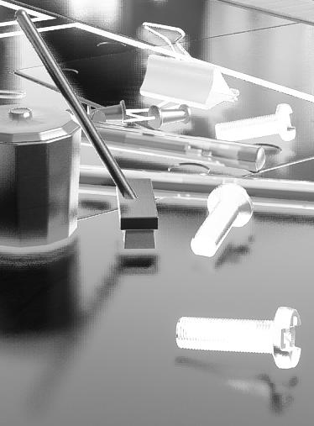
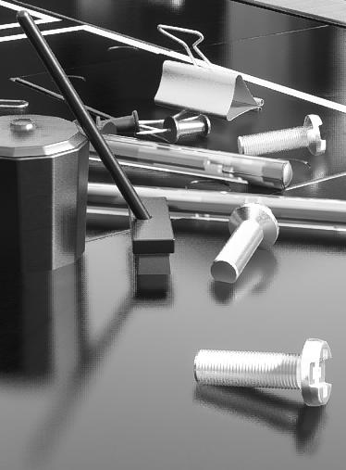
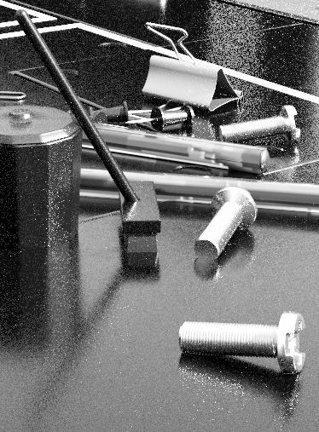
Screen-Space Reflections
G-Buffer Raytraced
Path Tracing Reference

Slide 15
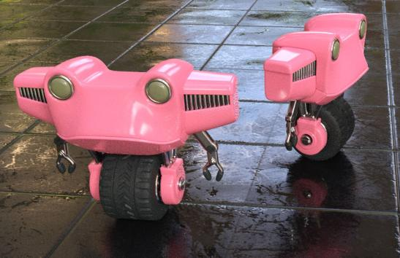
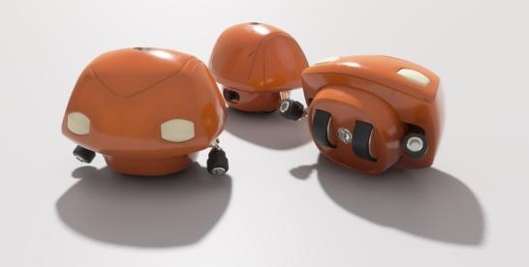
S E E D // Shiny Pixels and Beyond: Rendering Research at SEED
Materials
Combine multiple microfacet surface layers into a single, unified & expressive BRDF
Inspired by Arbitrarily Layered Micro-Facet Surfaces [Weidlich 2007]
Unified for all lighting & rendering modes
Raster, path-traced reference, and hybrid
Energy conserving & Fresnel
Rapidly experiment with different looks
Bake down number of layers for production
Objects with Multi-Layered Materials

Slide 16
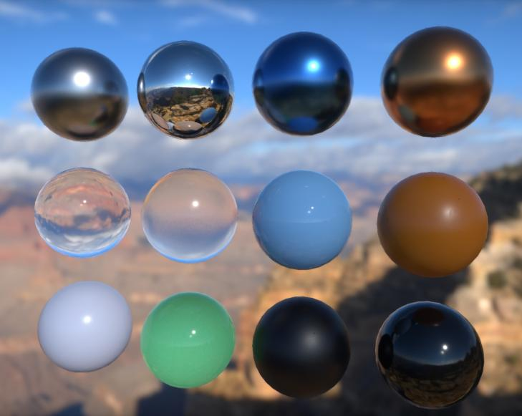
S E E D // Shiny Pixels and Beyond: Rendering Research at SEED
Materials
Standard
Aluminum
Brushed Aluminum
Coated Carbon
Copper
Silver Satin
Shiny / Mat Plastic
Dark Rubber
Exotics*
Glass
Rough Glass
Jade / Marble
* Integrated in BRDF, but built separately
Multi-Layered Materials

Slide 17
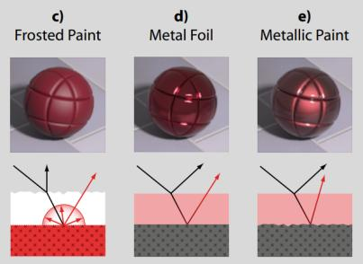
S E E D // Shiny Pixels and Beyond: Rendering Research at SEED
BRDF Sampling
General idea: Launch one ray for the whole stack
Stochastically select a layer & sample
When evaluating material, estimate visibility vs other layers
Some energy is reflected, some is refracted:
Microfacet: Fresnel (refracted = 1-Fresnel)
Diffuse: reflected fraction equal to albedo, remaining light absorbed; no refraction
Sample BSDF of selected layer
Attenuated by layer(s) on top
Result is temporally filtered
A single value for many layers requires clever filtering
Multi-Layered Materials [Weidlich 2007]

Slide 18
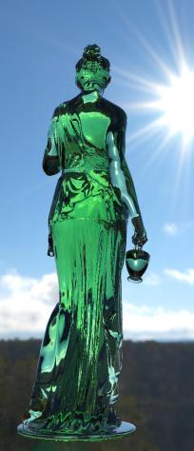
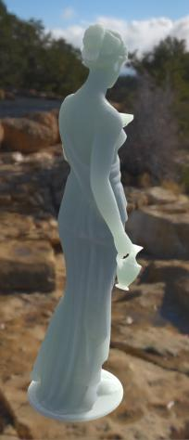
S E E D // Shiny Pixels and Beyond: Rendering Research at SEED
Transparency & Translucency
Raytracing allows to unify reflections and refractions
Glass
Order-independent (OIT)
Handles multiple IOR transitions
Translucency
Inspired from Translucency in Frostbite [Barré-Brisebois 2011]
Inner structure scattering based on lighting traveling inside the medium
Performance: we do it in texture-space
Glass and Translucency

Slide 19

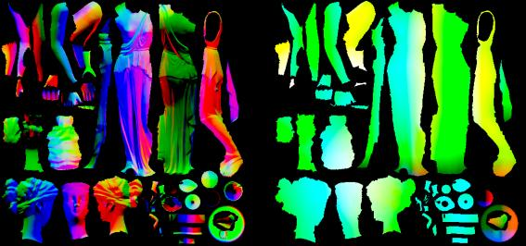
S E E D // Shiny Pixels and Beyond: Rendering Research at SEED
Translucency Breakdown
For every valid position & normal

Slide 20
S E E D // Shiny Pixels and Beyond: Rendering Research at SEED
Translucency Breakdown
For every valid position & normal
Flip normal and push (ray) inside

Slide 21
S E E D // Shiny Pixels and Beyond: Rendering Research at SEED
Translucency Breakdown
For every valid position & normal
Flip normal and push (ray) inside
Launch rays in uniform sphere dist.
Alternatively, front + back cosine lobes
Perf: only do n-rays per frame

Slide 22
S E E D // Shiny Pixels and Beyond: Rendering Research at SEED
Translucency Breakdown
For every valid position & normal
Flip normal and push (ray) inside
Launch rays in uniform sphere dist.
Alternatively, front + back cosine lobes
Perf: only do n-rays per frame
Compute lighting at intersection
Sample previous translucency result

Slide 23
S E E D // Shiny Pixels and Beyond: Rendering Research at SEED
Translucency Breakdown
For every valid position & normal
Flip normal and push (ray) inside
Launch rays in uniform sphere dist.
Alternatively, front + back cosine lobes
Perf: only do n-rays per frame
Compute lighting at intersection
Sample previous translucency result
Gather
Modulate with Beer-Lambert or Henyey-Greenstein phase function

Slide 24
S E E D // Shiny Pixels and Beyond: Rendering Research at SEED
Translucency Breakdown
For every valid position & normal
Flip normal and push (ray) inside
Launch rays in uniform sphere dist.
Alternatively, front + back cosine lobes
Perf: only do n-rays per frame
Compute lighting at intersection
Sample previous translucency result
Gather
Modulate with Beer-Lambert or Henyey-Greenstein phase function
Store new BTDF value

Slide 25
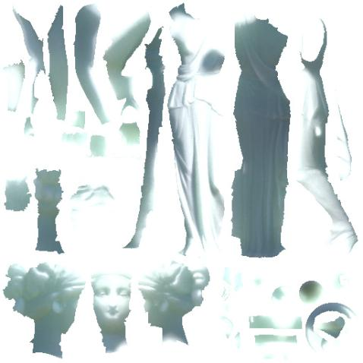
S E E D // Shiny Pixels and Beyond: Rendering Research at SEED
Translucency Filtering
Result converges over a couple frames
Denoised or temporally-accumulated
Temporal: build an update heuristic
Exponential moving average can be OK
Game-specific threshold to update
Reactive enough for moving lights & objects
Variance-adaptive mean estimation

Slide 26
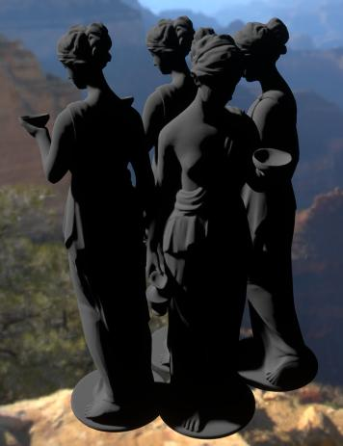
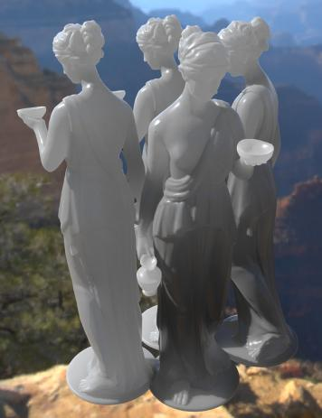
S E E D // Shiny Pixels and Beyond: Rendering Research at SEED
Translucency Shadowing
Raytracing allows for globally shadowed translucency
Global phenomena
Integration via feedback
Objects occlude each other
Overall more grounded and visually-convincing translucency
Direct Lighting
Self-Shadowed Translucency

Slide 27
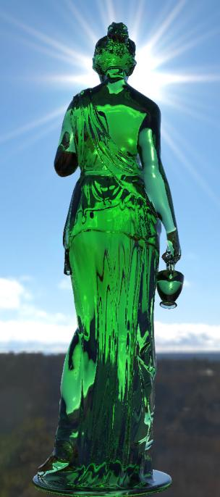
S E E D // Shiny Pixels and Beyond: Rendering Research at SEED
Transparency
Similar approach is used for glass
Launch ray using view’s origin and direction
Refract based on medium's index-of-refraction (IOR)
Snell’s law: refract(ray, N, iorInput / iorOutput)
DXR: HitKind() to handle IOR transitions (Air ⇔ Glass)
Trace a ray in the scene & sample lighting
Tint the result by glass color + chromatic aberration

Slide 28
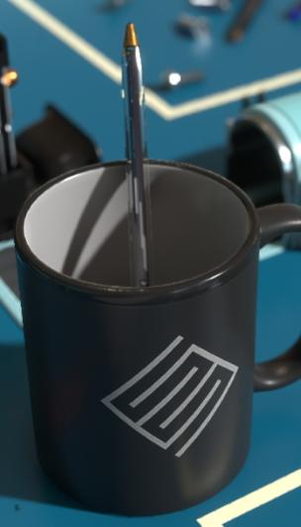
S E E D // Shiny Pixels and Beyond: Rendering Research at SEED
Transparency
Similar approach is used for glass
Launch ray using view’s origin and direction
Refract based on medium's index-of-refraction (IOR)
Snell’s law: refract(ray, N, iorInput / iorOutput)
DXR: HitKind() to handle IOR transitions (Air ⇔ Glass)
Trace a ray in the scene & sample lighting
Tint the result by glass color + chromatic aberration
Pen: we don’t handle transparent shadows yet

Slide 29
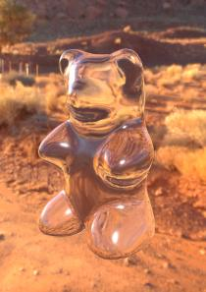
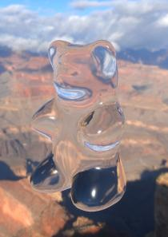

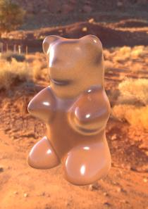
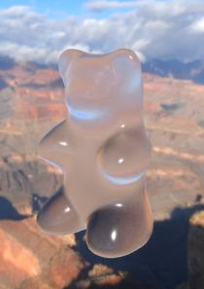
S E E D // Shiny Pixels and Beyond: Rendering Research at SEED
Transparency
Works for clear and rough glass
Clear
No filtering required
Rough / Blurry
Open cone angle with Uniform Cone Sampling [PBRT]
Wider cone → more samples
Or temporal filtering
Tint with phase function and more complex BTDF

Slide 30
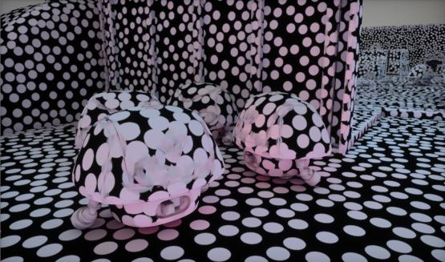
S E E D // Shiny Pixels and Beyond: Rendering Research at SEED
Global Illumination
We want a technique that:
Doesn’t require any precomputation
Doesn’t require parametrization (UVs, proxies)
Works for both static and dynamic scenes
Adaptive & refines itself on-the-fly
Point-based / surfels for a dynamic world
Runtime Monte-Carlo integration

Slide 31

S E E D // Shiny Pixels and Beyond: Rendering Research at SEED
Surfel Placement
Surfel Spawning From Camera @ 1% speed

Slide 32
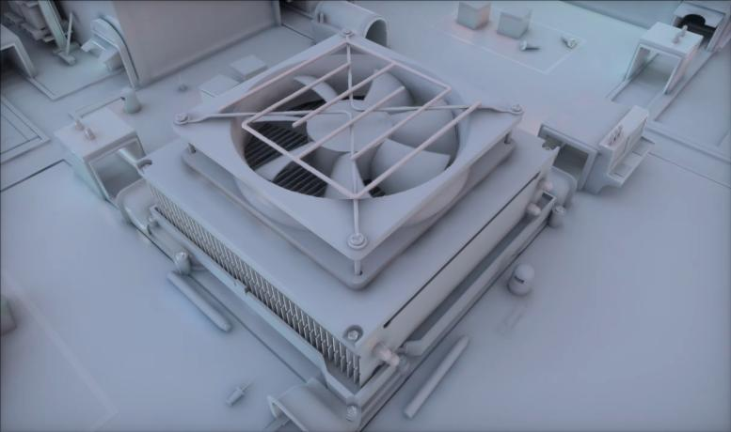
S E E D // Shiny Pixels and Beyond: Rendering Research at SEED
Surfel Placement
Skinned Surfels for Dynamic Objects

Slide 33
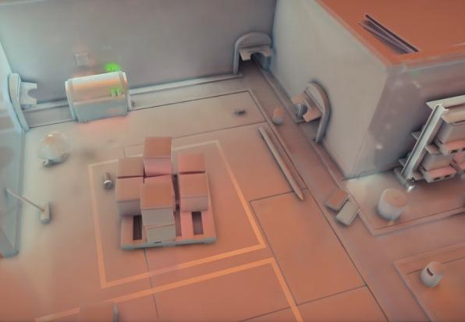
S E E D // Shiny Pixels and Beyond: Rendering Research at SEED
Sampling & Integration
Compute surfel irradiance by PT
When shooting rays/frame
Limit depth and number of paths
Limiting depth != fewer bounces
Reuse results from previous frames
1 = radiosity, ∞ = path tracing
Variance-adaptive mean estimator
Progressive Integration (slowed down for clarity)
Application (Binning, culling, half-res apply + upsample)

Slide 34
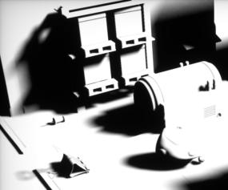
S E E D // Shiny Pixels and Beyond: Rendering Research at SEED
Shadows
Accumulated and filtered in screen-space
Raygen: Launch a ray towards light
Payload’s miss flag set to true (from Miss Shader) if it doesn’t hit geometry
Penumbra driven by uniform cone sampling [PBRT]
Temporal Reprojection
Accumulates shadow and variance + TAA-style bounding box clamping
Filter (SVGF-like) [Schied and NVIDIA 2017]
Multipass weighted spatial blur, driven by variance from temporal accumulation

Slide 35
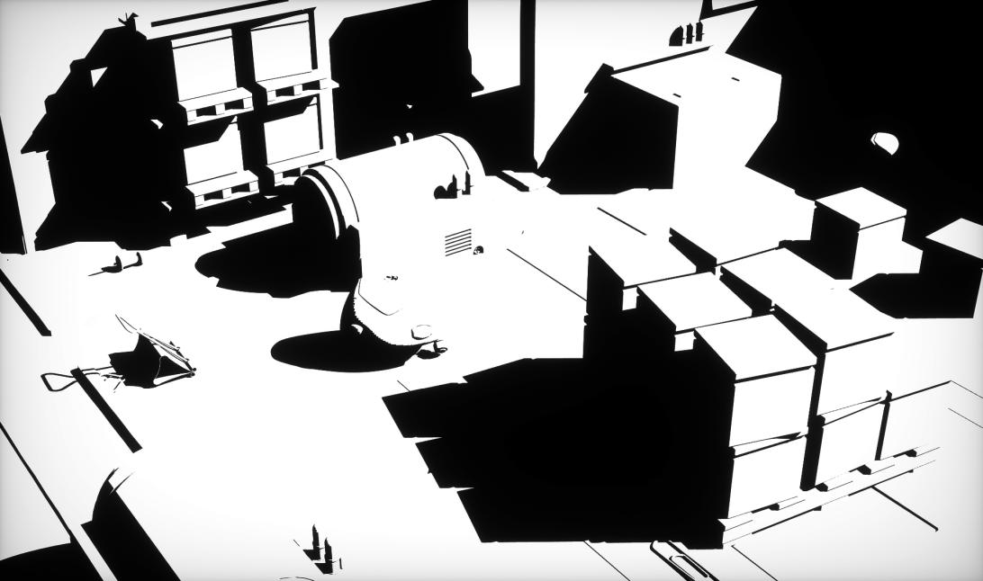
Hard Raytraced Shadows

Slide 36
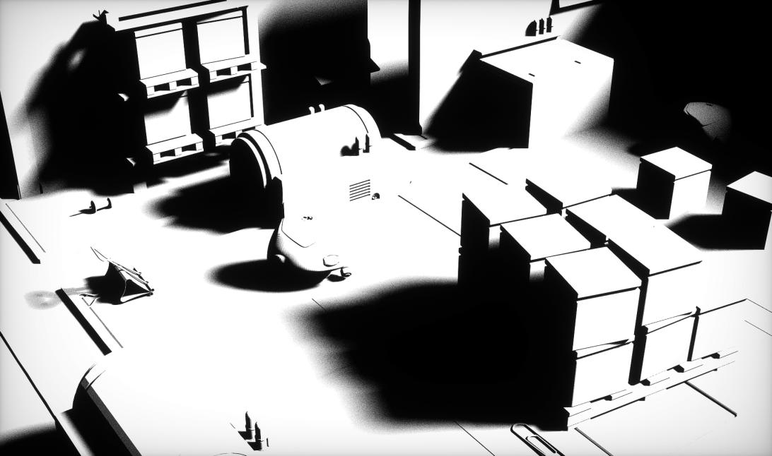
Soft Raytraced Shadows (Unfiltered)

Slide 37

Soft Raytraced Shadows (Filtered)

Slide 38
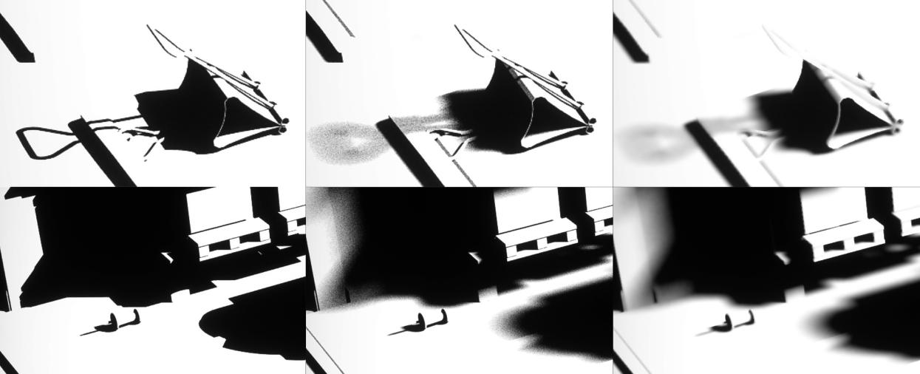
Hard Raytraced Shadows
Soft Raytraced Shadows (Unfiltered)
Soft Raytraced Shadows (Filtered)

Slide 39
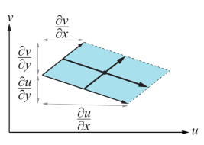
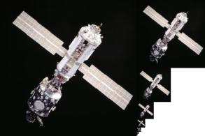
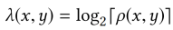

S E E D // Shiny Pixels and Beyond: Rendering Research at SEED
Texture Level-of-Detail
What about texture level of detail?
Mipmapping [Williams 1983] is the standard method to avoid texture aliasing:
Screen-space pixel maps to approximately one texel in the mipmap hierarchy
Supported by all GPUs for rasterization via shading quad and derivatives
Left: level-of-detail (λ), partial derivatives and the parallelogram-approximated texture-space footprint of a pixel. Right: mipmap chain

Slide 40
S E E D // Shiny Pixels and Beyond: Rendering Research at SEED
Texture Level-of-Detail
No shading quads for ray tracing!
Traditionaly: Ray Differentials
Estimates the footprint of a pixel by computing world-space derivatives of the ray with respect to the image plane
Have to differentiate (virtual offset) rays
Heavier payload (12 floats) for subsequent rays (can) affect performance. Optimize!
Surface
P(x + ∂x)
y
∂x
P(x)
∂P(x)
D(x + ∂x)
D(x)
∂D(x)
R(x)
D(x)
x
R(x + ∂x)
Ray Differentials [Igehy99]
Alternative: always sample mip 0 with bilinear filtering (with extra samples)
Leads to aliasing and additional performance cost

Slide 41


S E E D // Shiny Pixels and Beyond: Rendering Research at SEED
Texture Level-of-Detail
Together with Research, we developed a texture LOD technique for raytracing:
Heuristic based on triangle properties, a curvature estimate, distance, and incident angle
Similar quality to ray differentials with single trilinear lookup
Single value stored in the payload for subsequent rays
Upcoming publication by:
Tomas Akenine-Möller (NV), Magnus Andersson (NV), Colin Barré-Brisebois (EA), Jim Nilsson (NV), Robert Toth (NV)
Ground Truth, Ray Differentials, Ours, Mip0

Slide 42

S E E D
Summary
S E E D // Shiny Pixels and Beyond: Rendering Research at SEED
Just the beginning – important new tool going forward
Unified API – easy to experiment and integrate
Flexible but complex tradeoffs - noise vs ghosting vs perf
Can enable very high quality cinematic visuals
Lots more to explore – perf, raster vs trace, sparse render, denoising, new techniques

Slide 43


S E E D // Shiny Pixels and Beyond: Rendering Research at SEED
SEED @ GDC 2018
DirectX: Evolving Microsoft's Graphics Platform (presented by Microsoft)
Johan Andersson and Colin Barré-Brisebois
Content will be available online soon at www.ea.com/seed
Deep Learning - Beyond the Hype
Magnus Nordin
Room 2016, West Hall, Thursday, March 22nd, 11:30am - 12:30pm
Creativity of Rules and Patterns: Designing Procedural Systems
Anastasia Opara
GDC Show Floor, Thursday, March 22nd, 12:30PM-1:00PM and Friday, March 23rd @ 11:00AM-11:30AM

Slide 44
S E E D // DirectX: Evolving Microsoft's Graphics Platform
Thanks
SEED
Joakim Bergdahl
Ken Brown
Dean Calver
Dirk de la Hunt
Jenna Frisk
Paul Greveson
Henrik Halen
Effeli Holst
Andrew Lauritzen
Magnus Nordin
Niklas Nummelin
NVIDIA
Tomas Akenine-Möller
Nir Benty
Jiho Choi
Peter Harrison
Alex Hyder
Jon Jansen
Aaron Lefohn
Ignacio Llamas
Henry Moreton
Martin Stich
Anastasia Opara
Kristoffer Sjöö
Tomasz Stachowiak
Ida Winterhaven
Graham Wihlidal
Microsoft
Chas Boyd
Ivan Nevraev
Amar Patel
Matt Sandy

Slide 45
S E E D // Shiny Pixels and Beyond: Rendering Research at SEED
References
[Harmer 2018] Jack Harmer, Linus Gisslén, Henrik Holst, Joakim Bergdahl, Tom Olsson, Kristoffer Sjöö and Magnus Nordin“ Imitation Learning with Concurrent Actions in 3D Games”. available online
[Barré-Brisebois 2011] Barré-Brisebois, Colin and Bouchard, Marc. “Approximating Translucency for a Fast, Cheap and Convincing Subsurface Scattering Look”, available online.
[Barré-Brisebois 2017] Barré-Brisebois, Colin. “A Certain Slant of Light: Past, Present and Future Challenges of Global Illumination in Games”, available online.
[Igehy 1999] Igehy, Homan. “Tracing Ray Differentials”, available online.
[PBRT] Pharr, Matt. Jakob, Wenzel and Humphreys, Greg. “Physically Based Rendering”, Book, http://www.pbrt.org/.
[Schied 2017] Schied, Christoph et. Al. “Spatiotemporal Variance-Guided Filtering: Real-Time Reconstruction for Path-Traced Global Illumination”, NVIDIA Research, available online.
[Stachowiak 2015] Stachowiak, Tomasz. “Stochastic Screen-Space Reflections”, available online.
[Weidlich 2007] Weidlich, Andrea and Wilkie, Alexander. “Arbitrarily Layered Micro-Facet Surfaces”, available online. [Williams 1983] Williams, Lance. “Pyramidal Parametrics”, available online.

Slide 46
S E E D / / S E A R C H F O R E X T R A O R D I N A R Y E X P E R I E N C E S D I V I S I O N
S t o c k h o l m – L o s A n g e l e s – M o n t r é a l – R e m o t e
w w w . e a . c o m / s e e d
W e ‘ r e H i r i n g !

Slide 47
Questions?

Slide 48
S E E D // Shiny Pixels and Beyond: Rendering Research at SEED
Bonus

Slide 49





S E E D // DirectX: Evolving Microsoft's Graphics Platform
Ambient Occlusion
Ambient Occlusion (AO) [Langer 1994] [Miller 1994] maps and scales directly with real-time ray tracing:
Integral of the visibility function over the hemisphere $Ω$for the point $\overline{p}$ on a surface with normal $\hat{n}$ with respect to the projected solid angle
Games often approximate this in screen-space
With RT, more grounded & improves visual fidelity!
Random directions $\hat{w}$
Can be temporally accumulated or denoised
$$\hat{n}$$
$$\overline{p}$$
$$A_{\overline{p}}=\frac{1}{π}\int_{Ω}{V_{\overline{p},\hat{w}}(\hat{n}⋅\hat{w})dω}$$

Slide 50

Screen-Space AO

Slide 51

Raytraced AO

Slide 52

Screen-Space AO

Slide 53

Raytraced AO (Same Radius as SSAO)

Slide 54

Raytraced AO (Far-field)

Slide 55

S E E D // DirectX: Evolving Microsoft's Graphics Platform
mGPU
GPU₁
GPU₂
GPU₃
GPU₄
Explicit Heterogenous Multi-GPU
Parallel Fork-Join Style
Resources copied through system memory using copy queue
Minimize PCI-E transfers
Approach
Run ray generation on primary GPU
Copy results in sub-regions to other GPUs
Run tracing phases on separate GPUs
Copy tracing results back to primary GPU
Run filtering on primary GPU
Ray Generation
Copy Sub Regions
Trace GPU 1
Trace GPU 2
Trace GPU 3
Trace GPU 4
Copy Sub Regions
Filter

Slide 56

Ray Tracing Gems
Call for Papers
A new book series with focus on real-time and interactive ray tracing for game development using the DXR API.
We invite articles on the following topics: Basic ray tracing algorithms, effects (shadows, reflections, tec), non-graphics applications, reconstruction, denoising, & filtering, efficiency and best practices, baking & preprocessing, ray tracing API & design, rasterization and ray tracing, global Illumination, BRDFs, VR, deep learning, etc.
Important dates
15th of October 2018: submission deadline for full papers
GDC 2019: publication of Ray Tracing Gems (paper version + e-book)
Tomas Akenine-Möller will lead the editorial team http://developer.nvidia.com/raytracinggems/

